Slide 1
Agentic Digital Banking:
Scenarios & Solution Architecture
Xiaohua Men (menxiaohua@unionpay.com)
Yulun Fang （fangyulun@unionpay.com）
Bing Liu (leo.liubing@huawei.com)
Qiangzhou Gao（Gaoqiangzhou@huawei.com）
Nan Geng (Gengnan@huawei.com)

Slide 2
Content
Digital banking Scenarios
  UnionPay Open Platform as a “bank hub”, various banking service based on the open platform
  Apps could access services from multiple banks through a single point of entry, and banks (especially small and medium-sized banks) could reach more application scenarios.
  ‌Build networks between scale scenarios and massive financial service, reducing business integration costs for both sides.
  Banking services is evolving to agentic
Agent Networking Use Case
  IPO auditing use case
  based on an on-going joint innovation project of UnionPay
  Agents in UnionPay and banks networked together through Agent Gateways

Slide 3
High-level illustration of digital banking system
UnionPay
  "Public Infrastructure" and "Rule-Setter" in the payment/financial domain in China.
Open Banking Platform
  All member banks adhere to the unified technical standards established by the alliance, seamlessly integrating their core systems with the alliance's central platform.
Commercial Bank 1
Commercial Bank 1
Agents
APIs
APIs
MCP/A2A
UnionPay
Open Platform
Commercial Bank 2
UnionPay
Open Platform
Commercial Bank 2
Users
Apps
Users
Agents
Agents
Agent
s
Agents
MCP/A2A
…
…
Commercial Bank N
Commercial Bank N
Agents
From API calling to Agentic Interconnection
  Traditional API calls demonstrate significant limitations when dealing with complex and ever-changing business environments.
  Agentic interconnection/orchestration fundamentally overturns the traditional models

Slide 4
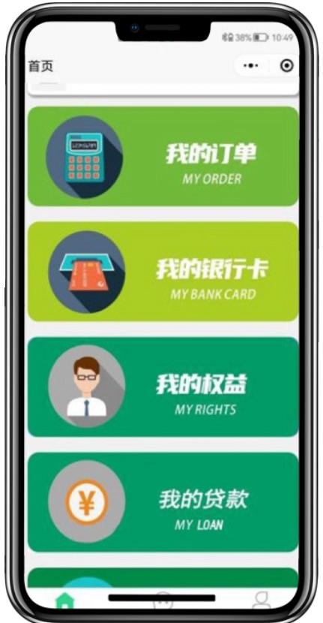
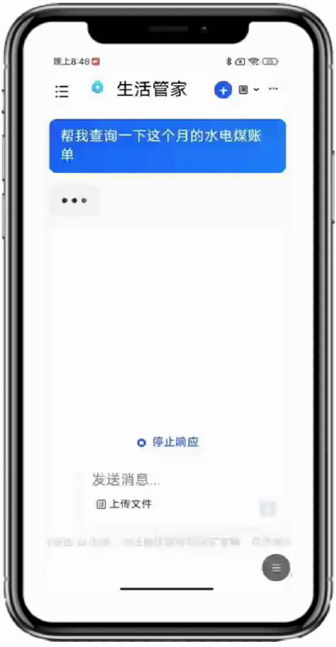
Examples of agentic banking service
Order management App
Business service (2B)
Retailers can apply for loans from partner banks within the order system. They can easily use the credit funds within the approved limit for order payments. UnionPay initiates real-time payment processing to the recipient‌ company's account, completing the entire process of order-based lending.
Agentic banking service bridge the gap between disparate standards and interfaces among applications and banks.
“Personal Butler” App
Personal service (2C )
Please check my utility bills (water, electricity, and gas) for this month.
On the app, intelligent recognition processes bills from text commands
supporting instant inquiry and payment for water, electricity, coal (heating), and gas fees.
This achieves the goal of "Tap once, and handle all your utility payments effortlessly."
Notes:
Open banking platforms enable retailers to complete a seamless, end-to-end process online for credit application, account opening, lending, and order tracking, which is far more efficient than obtaining loans through third-party internet firms.

Slide 5
IPO Auditing Use Case and the Solution System Architecture
IPO auditing use case
  when a company applies for listing, underwriters and lawyers need to conduct a thorough review of the company's bank account transactions to verify the authenticity of its revenue and the compliance of its funds.
  Companies normally hold accounts in dozens of different banks, that the review process becomes extremely cumbersome.
  The digital interconnection system established by the banking alliance plays a critical role.
PoC System Architecture
CA
Identity Infrastructure
Agent Gateway
（All-in-one Box）
Acquiring service list
Registration
MCP Server reg
Agent reg
API reg
Wallet service
I/O Mapping
User
Agent
Compliance reqs
Inter-orgs reqs
Compliance
Compliance reqs
Inter-orgs reqs
Account service
Point-to-Point
direct interaction
prompt
tokens
LLM
Domain Specific Models
Private Models
General Models
  Designed based on the IPO auditing use case, but also has some degree of versality
  Agent Gateway as the core components, providing all-in-one service including networking/computing/security

Slide 6



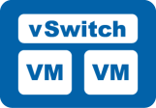
Networking view of the IPO Auditing use case
Underlay Network Deployment View
Border Leaf
Border Leaf
Bank
Data Center
UnionPay
Data Center
Spine
Spine
Agent Gateway
Network
Leaf
Network
Leaf
Computing Leaf
Computing Leaf
IPO Sponsor
Agent
Gateway
Agent
Gateway
Agent
Node
Agent
Node
Agent
Gateway
Agent
Gateway
Agent
Node
Agent
Node
Network Area
Computing Area
Network Area
Computing Area
Agent Gateway Interconnection Overlay View
Agent Gateway
Agent Gateway
Agent Gateway
Agent registration
Agent Gateway discovery
Agent addressing
Agent connection establishment
Agent service-level interaction
Underlay network assurance
②
③
②
①
④⑤
Bank 1
①
①
Agent Gateway
①
IPO Sponsor
UnionPay
Bank 2

Slide 7
Conclusion
Agent Gateway as an Unified Service Point
  The unified gateway ensures that application partners only need to interface with UnionPay at one point.
  UnionPay could efficiently connect over 3,000 commercial banks and financial institutions via a single interface.
Intelligent and Secure Communication Enabler
  The UnionPay Smart Gateway is capable of understanding the application partner's business needs, decomposing the tasks, and then forwarding them to the target bank Agents for execution, leading to more efficient transactions.
  This mechanism gives UnionPay deep control over the business flow, enabling it to achieve business penetration management and connection management for both the application partners and the commercial banks.
  Data sharing could also leverage the gateway system, benefiting all partners and encouraging further banking service innovations.

Slide 8
Thank You!
Further reading:
https://datatracker.ietf.org/doc/draft-men-rtgwg-agent-networking-in-digibank/
https://datatracker.ietf.org/doc/draft-zlgsgl-rtgwg-agents-networking-framework/

